Slide 1
Clark Scorecards
File created on: 5/28/2020 1:38:05 PM

Slide 2
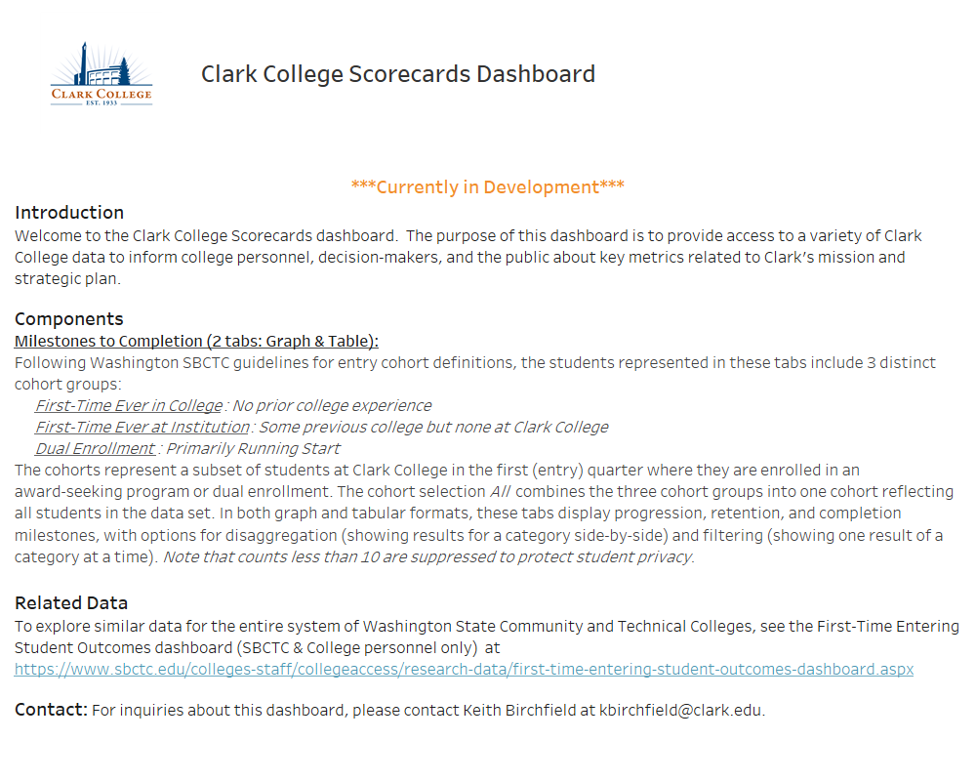

Slide 3
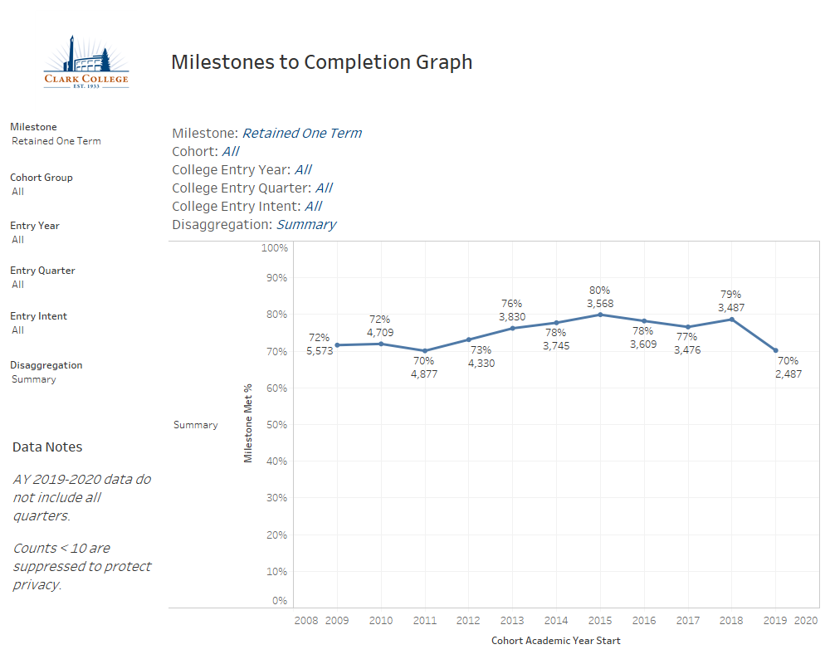

Slide 4
